Slide 1

UNIX Internals

Slide 2
References
These slides are prepared by referring to the following sources. Most of the diagrams are from these sources.
Bach’s Design of the UNIX Operating system
Steven’s Advance Programming in the UNIX Environment
Steven’s UNIX Network Programming
World wide web

Slide 3
What is an OPERATING SYSTEM ?
Major Services
File Management System
Memory Management System
Process Management Sysem
Network Management
Examples: UNIX, GNU/Linux, Windows, MacOS X, HP-UX, IBM-AIX etc.

Slide 4
Operating System Services
Controlling execution of process
creation, termination, suspension and IPC
Scheduling the execution of process
Allocating main memory for an executing process
Allocating secondary memory for efficient storage and retrieval of user data
Allowing process controlled access to peripheral devices

Slide 5
What is RTOS ?
A real-time operating system (RTOS) is an operating system intended to serve real-time application requests. It must be able to process data as it comes in, typically without buffering delays. Processing time requirements (including any OS delay) are measured in tenths of seconds or shorter.
Examples: LynxOS, VxWorks, RTLinux, QNX, Windows CE etc.
Note: Majorly used for embedded applications

Slide 6
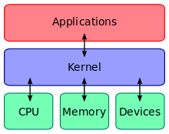
Why is OS required ?
It abstracts the hardware
Provides application with required services

Slide 7
1. UNIX - Features
Written in C
Simple user interface
Hierarchical file system – easy to maintain
Consistent format for files
Multi-user and Multi-processing
Hides machine architecture – easy to write programs that run on different hardware implementations

Slide 8
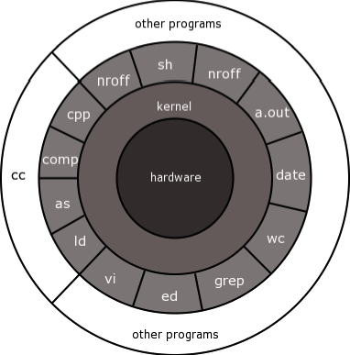
1. UNIX – System Architecture

Slide 9
A Process in UNIX
Program – An executable file – A process
All processes in UNIX are created by fork(2) other than process 0
User Process and System Process
ps –ef

Slide 10
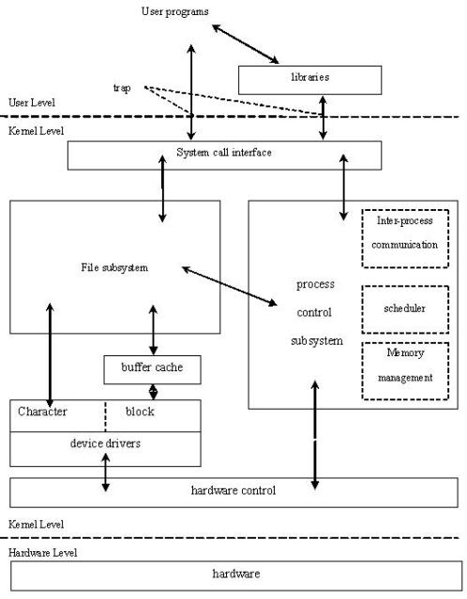
UNIX Kernel – Block Diagram

Slide 11
User Space V/S Kernel Space
User space is that set of memory locations in which user processes (i.e., everything other than the kernel) run. A process is an executing instance of a program. One of the roles of the kernel is to manage individual user processes within this space and to prevent them from interfering with each other.
Kernel space is where the kernel (i.e., the core of the operating system) executes (i.e., runs) and provides its services.
Kernel space can be accessed by user processes only through the use of system calls. System calls are requests in a Unix-like operating system by an active process for a service performed by the kernel, such as input/output (I/O) or process creation.

Slide 12
User mode V/S Kernel mode
When a process executes a system call, the execution mode of the process changes from user mode to the kernel mode
Hardware knows only modes

Slide 13
MMU implements virtual memory system. Swapper schedules allocation of memory to processes
Process Scheduler allocates CPU to processes (based on scheduling algorithm)
MMU implements virtual memory – Making fool by giving a feel of huge memory to support multi-programming – Implemented through Demand Paging
Logical Addresses – Divided into Pages
Physical Addresses – Divided into Frames

Slide 14
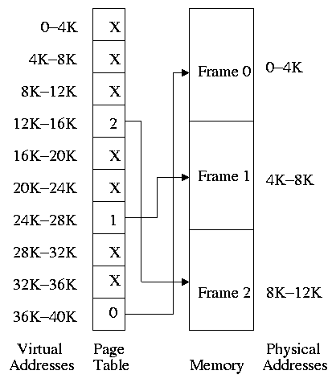
Paging

Slide 15
Before we start…
Login name
/etc/passwd
Shell ( echo $SHELL ) Ex: bash, ksh, csh
Current working directory ($pwd)
Home directory (echo $HOME)
User ID (/etc/passwd )
Group ID (/etc/passwd)

Slide 16
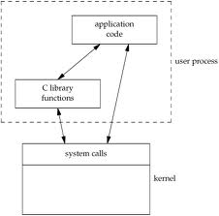
System Calls and Library Functions

Slide 17
How system calls work ?
Generally, each system call has a wrapper function in a library that is available (linked by) every program on the system. The wrapper function has 3 main tasks:
Collect all of the parameters to the system call. E.g., the read system call to read data from a file. These parameters are placed in CPU registers, or may be placed in a data structure whose address is placed in a CPU register.
Invoke the system call. Uses a special instruction that causes a trap to the operating system.
When the kernel finishes processing the system call, it returns control to the process. The wrapper function finishes by getting the return code from the system call and returning it to the caller.

Slide 18
Time Values
Calendar Time
No. of seconds since the Epoch: 00:00:00 January, 1, 1970
Primitive systems data type is time_t
Process Time
Measured as ticks per second (50, 60 or 100 ticks per second). Primitive system data type is clock_t
Clock Time
User CPU Time
System CPU Time
time(1)
$time -p grep _POSIX_SOURCE */*.h > /dev/null

Slide 19
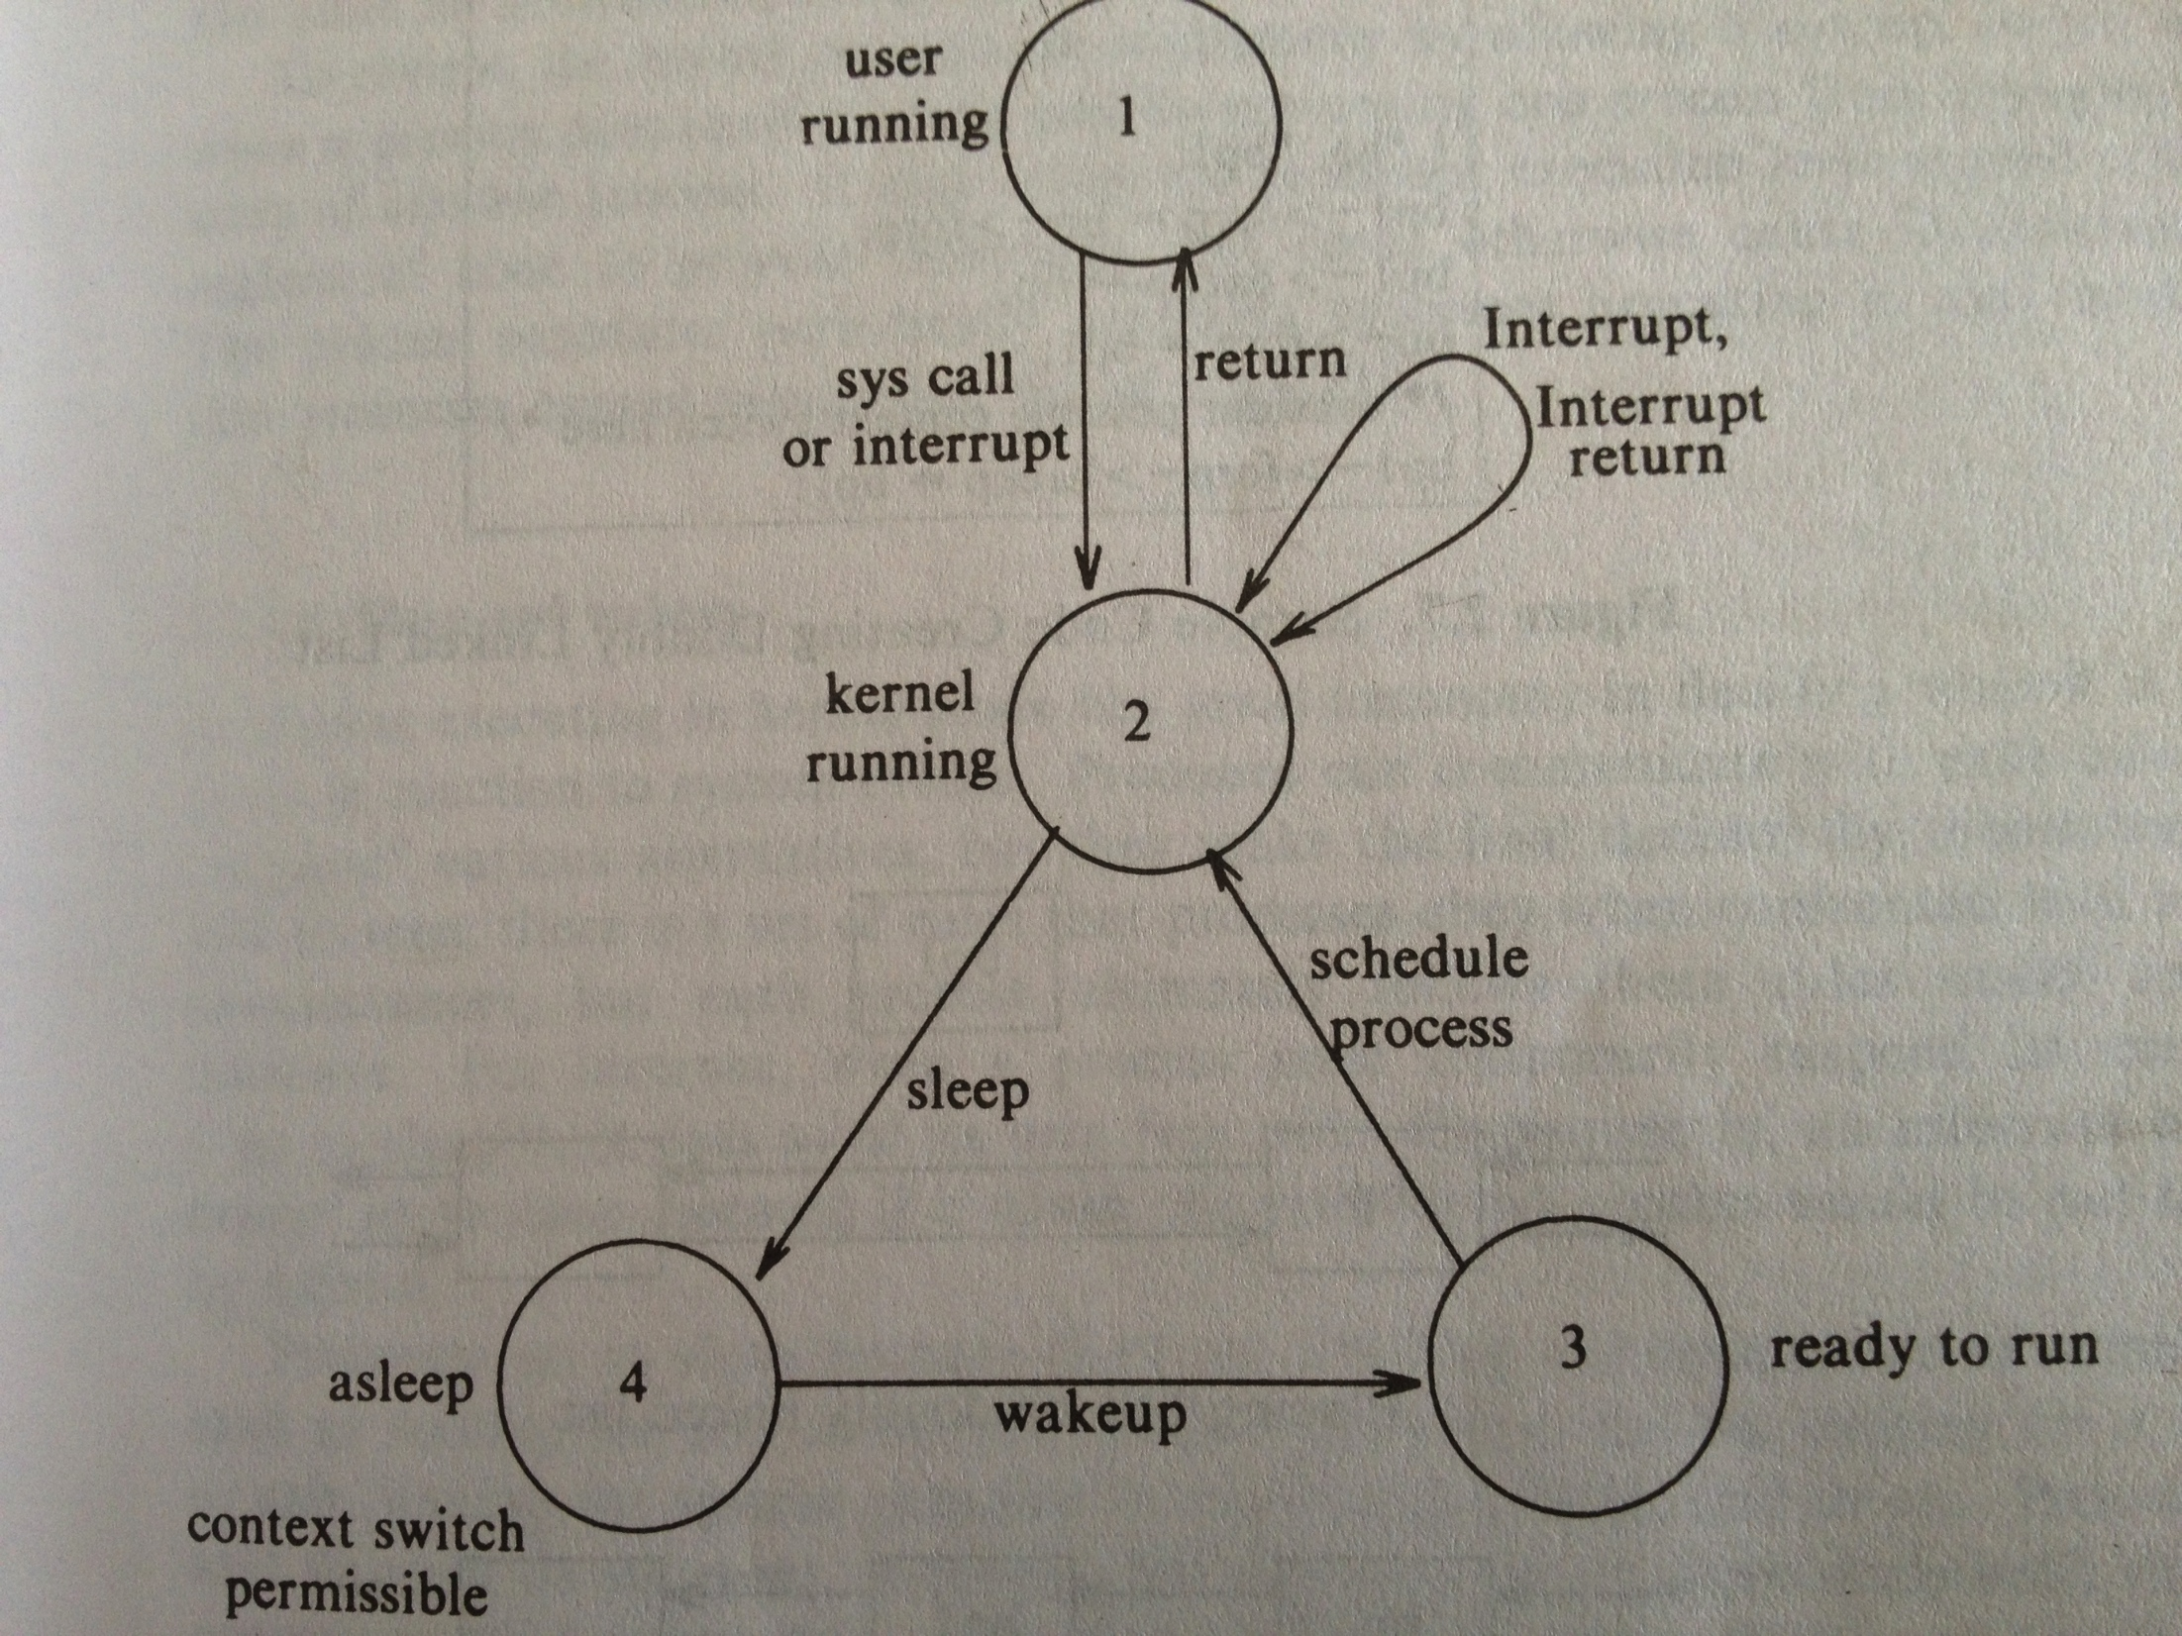
Process States

Slide 20
Limits
Compile-time limits
Headers ( limits.h )
Run-time limits
System configuration run-time limits
syconf(3)
File configuration run-time limits
pathconf(3)
fpathconf(3)

Slide 21
File Types
Regular File
Text File
Binary File
touch(1) and rm(1)
Directory
mkdir(1) or mkdir(2)
rmdir(1) or rmdir(2)
rm(1)
FIFO
mkfifo(1) or mkfifo(3)
mknod(1) or mknod(2)
rm(1)
Device File
Char device file
Block device file
mknod(1) or mknod(2) or rm(1) with su privileges
Links
Hard Links and Soft links
ln(1) or link(2) and rm(1)

Slide 22
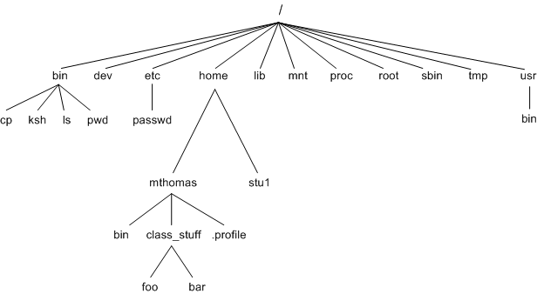
UNIX File System

Slide 23
Pathnames
Absolute Pathnames
/root/home/subhash/1.c
Relative Pathnames
../../etc/passwd
. means current directory
.. means parent directory

Slide 24
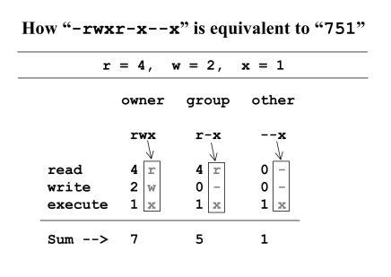
File Permissions
To try:
ls (1) , umask(1), chmod(1)

Slide 25
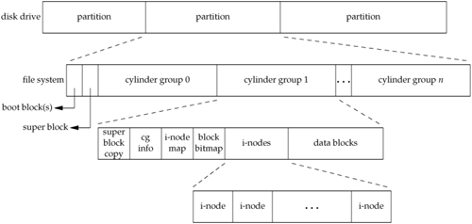
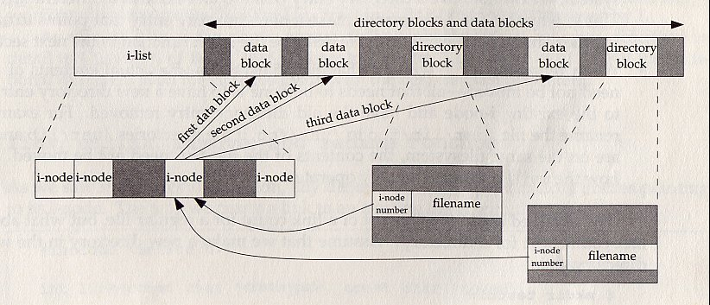
File System blocks

Slide 26
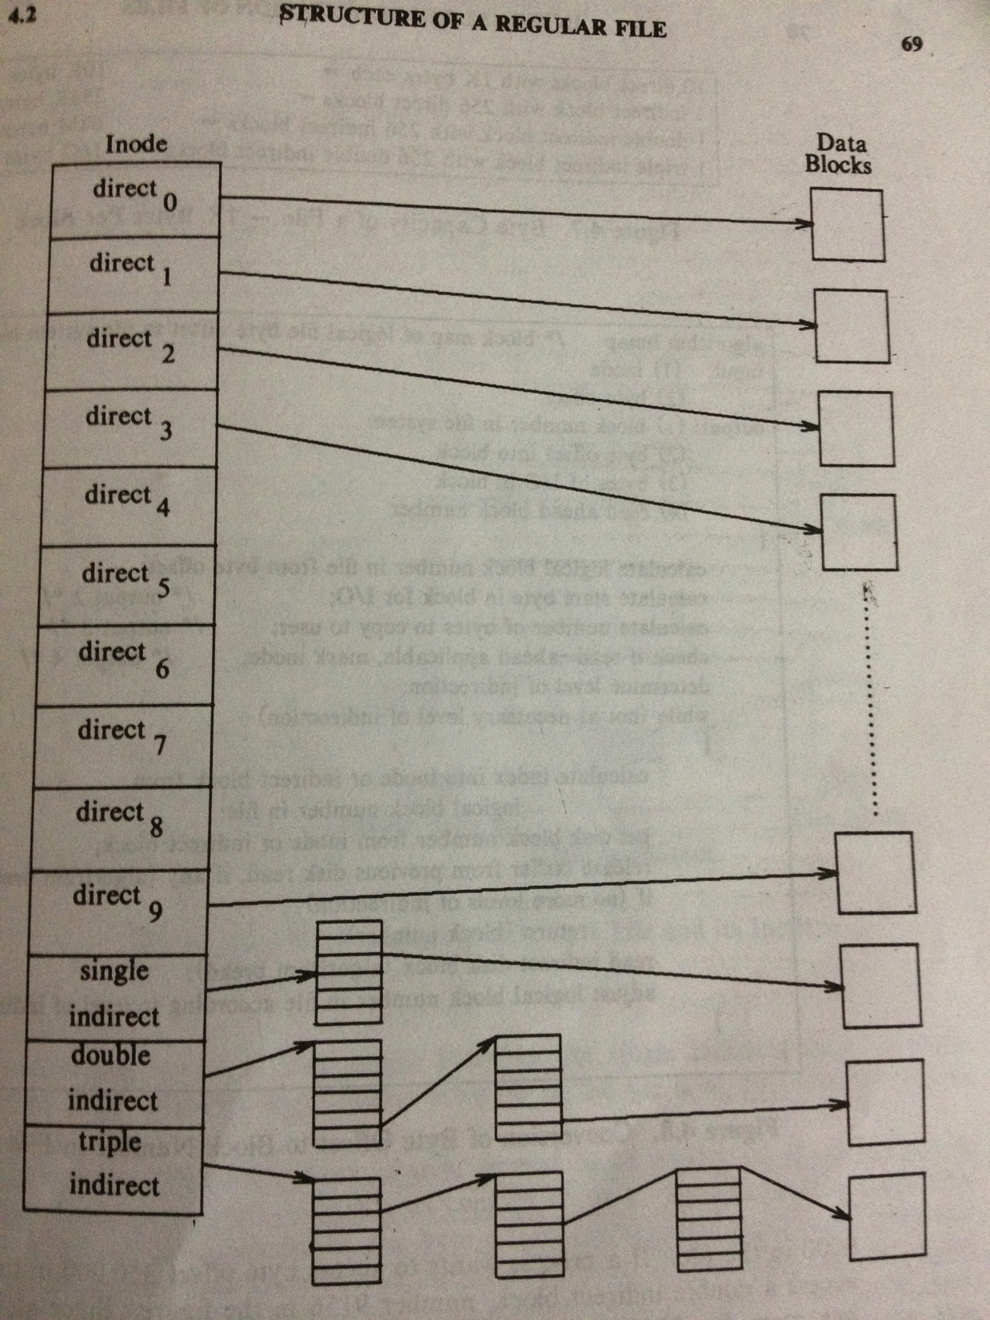
Inode Table

Slide 27
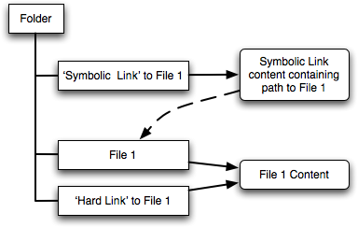
Hard links and Soft links
1. ln /home/subhash/file /home/subhash/hlink
2. ln –s /home/subhash/file /home/subhash/slink

Slide 28
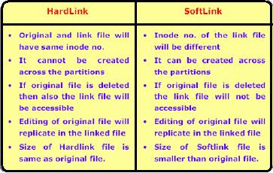
Difference between Hard links and Soft links

Slide 29
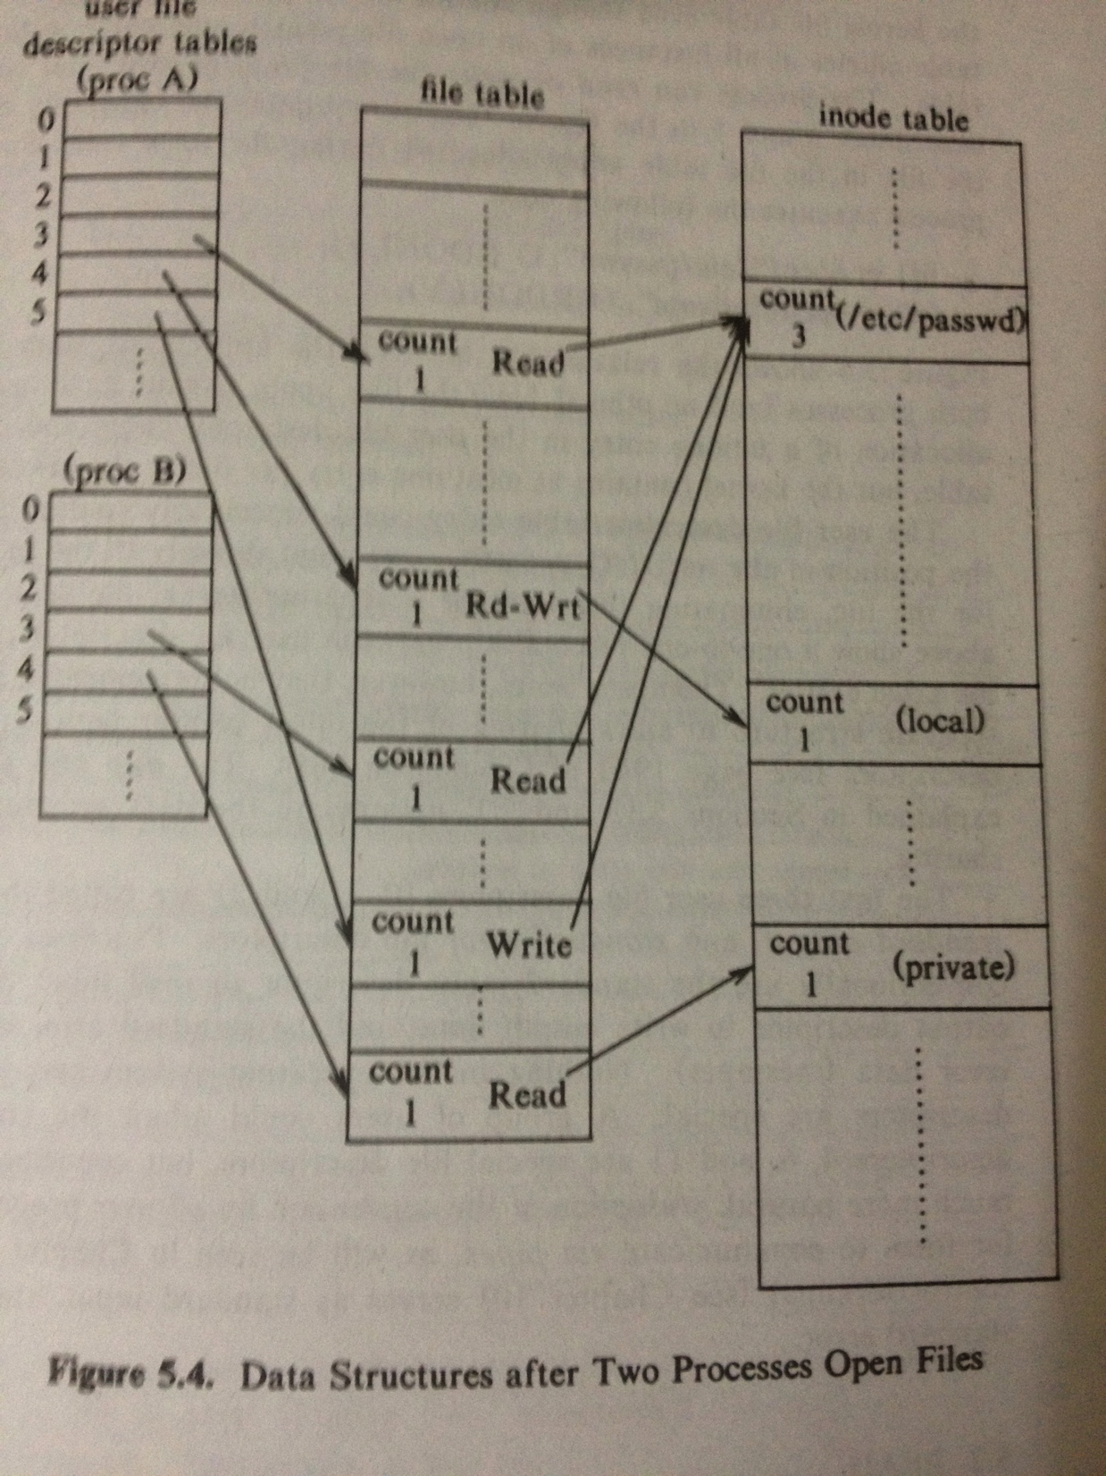
Kernel Support for files

Slide 30
Atomic Operations
Append using 2 system calls: No atomicity
lseek( fd, 0L, 2);
write(fd, buff, 100);
Append using O_APPEND : atomicity achieved
open( “./1.txt”, O_WRONLY | O_APPEND );

